Slide 1
Unit 3

Slide 2

Advance organizer
Learning objectives:
Understand 4.1 Quadratic Functions and Transformation
Prior knowledge:
Understand 3.3 Solving Systems of Inequalities
Successful criteria:
Controlled Practice: Complete the Exit Card
Freer Practice: Complete questions to your interest
Learning activities:
1. Preview and Vocabulary Check (10 minutes):
Quickly scan through the text and noting any unfamiliar terms.
2. Comprehend the Presentation (45 minutes):
3. Exit Card Completion (25 minutes):
4. Main Idea Summary and Reflection (5 minute):

Slide 3
Key terms:
Parabola (抛物线): A U-shaped curve that is symmetric and can open upwards or downwards. It is a type of quadratic curve.
Quadratic Function (二次函数): A function that can be expressed in the form f(x) = ax^2 + bx + c, where a, b, and c are constants and a is not equal to 0. It is a second-degree polynomial function.
Vertex (顶点): The point on a parabola where it reaches its maximum (if the parabola opens downward) or minimum (if the parabola opens upward) value. It is also called the "extremum" point.
Vertex Form (顶点形式): A specific form of writing a quadratic function as f(x) = a(x-h)^2 + k, where (h, k) represents the coordinates of the vertex of the parabola.
Axis of Symmetry (对称轴): A vertical line that passes through the vertex of a parabola, dividing it into two equal halves that are mirror images of each other.

Slide 4
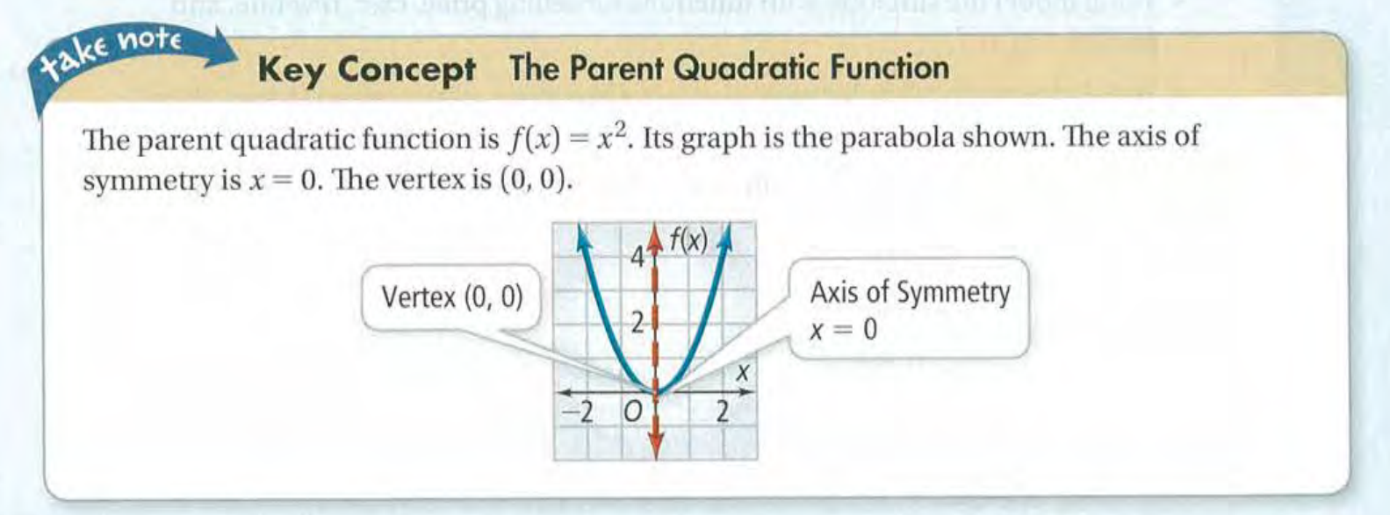

Slide 5
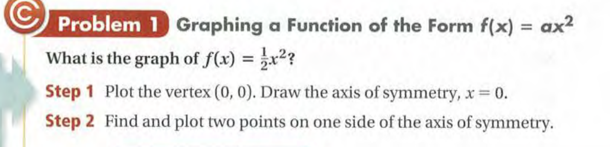
Graphing a Quadratic Function

Slide 6
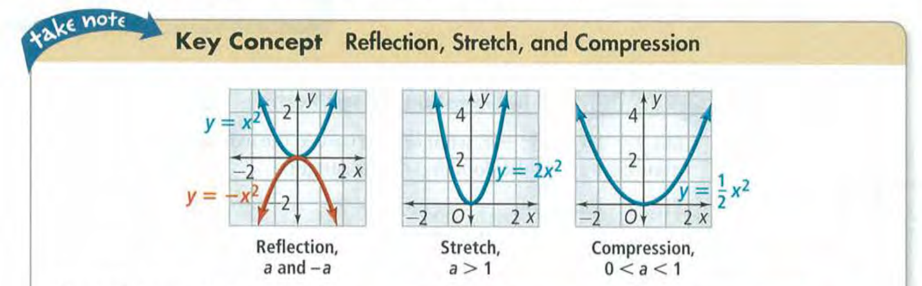
Transformation with Quadratic Function

Slide 7
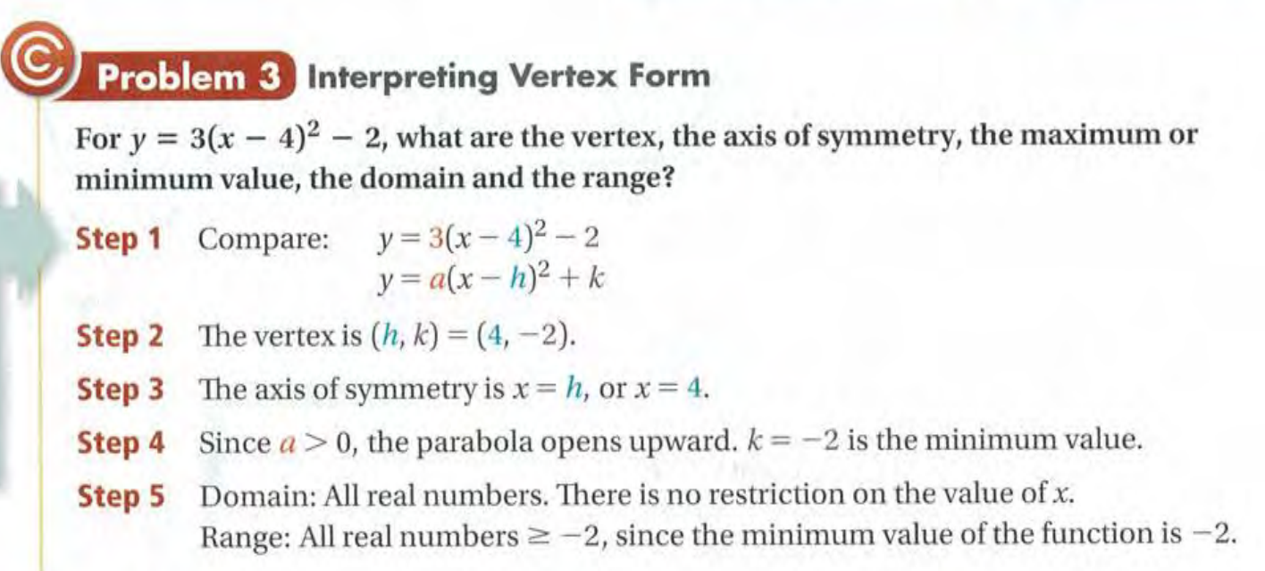
Vertex Form

Slide 8
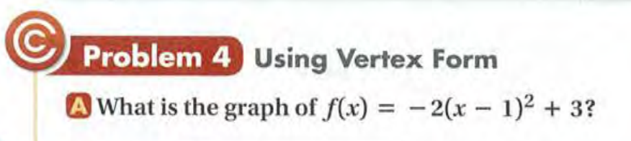
Vertex Form

Slide 9
Exit Card:
Complete Quadratic Functions and Transformation Learning sheet!

Slide 10
Advance organizer
Learning objectives:
Understand 4.2 Factoring Quadratic Expressions and Completing the square
Prior knowledge:
Understand 4.1 Quadratic Functions and Transformation
Successful criteria:
Controlled Practice: Complete the Exit Card
Freer Practice: Complete questions to your interest
Learning activities:
1. Preview and Vocabulary Check (10 minutes):
Quickly scan through the text and noting any unfamiliar terms.
2. Comprehend the Presentation (45 minutes):
3. Exit Card Completion (25 minutes):
4. Main Idea Summary and Reflection (5 minute):

Slide 11
Key terms:
Factoring (因式分解): Factoring is the process of breaking down a mathematical expression or number into its constituent factors, which are the numbers or expressions that, when multiplied together, give the original expression or number.
GCF (最大公因数): GCF stands for "Greatest Common Factor," and it refers to the largest number that evenly divides two or more numbers without leaving a remainder. It is also known as the "highest common factor" or "greatest common divisor (GCD)."
Completing the Square (配方完全平方): Completing the square is a mathematical technique used to manipulate a quadratic equation into a specific form, where it can be easily solved.

Slide 12
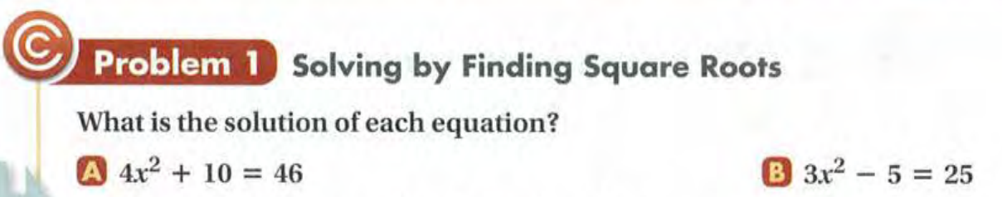

Slide 13
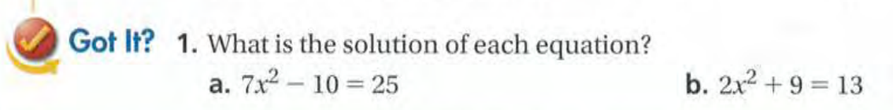

Slide 14
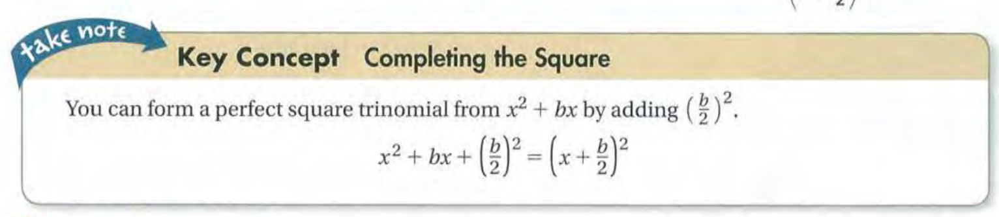

Slide 15
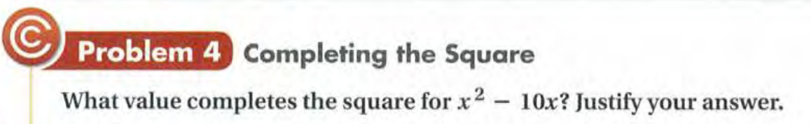

Slide 16
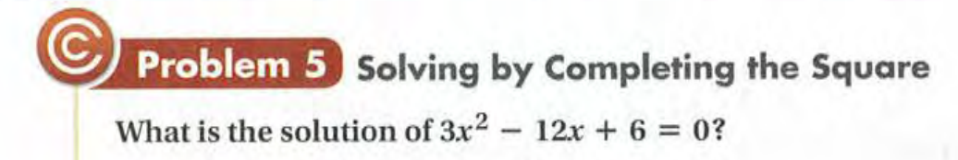

Slide 18
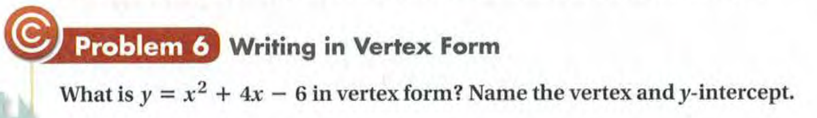

Slide 19
Exit Card:
Complete the learning sheets!
1. Factoring Quadratic Expressions
2. Completing the Square

Slide 20
Advance organizer
Learning objectives:
Understand 4.7 The Quadratic Formula
Prior knowledge:
Understand 4.2 Factoring Quadratic Expressions and Completing the square
Successful criteria:
Controlled Practice: Complete the Exit Card
Freer Practice: Complete questions to your interest
Learning activities:
1. Preview and Vocabulary Check (10 minutes):
Quickly scan through the text and noting any unfamiliar terms.
2. Comprehend the Presentation (45 minutes):
3. Exit Card Completion (25 minutes):
4. Main Idea Summary and Reflection (5 minute):

Slide 21
Key terms:
The Quadratic Formula [二次方程公式]: A formula used to find the solutions (roots) of a quadratic equation of the form ax^2 + bx + c = 0, where a, b, and c are constants, and "x" represents the variable.
Discriminant [判别式]: In the context of the quadratic equation, the discriminant is a value calculated from the coefficients of the equation (a, b, and c) and is used to determine the nature of the roots (solutions) of the equation.

Slide 22
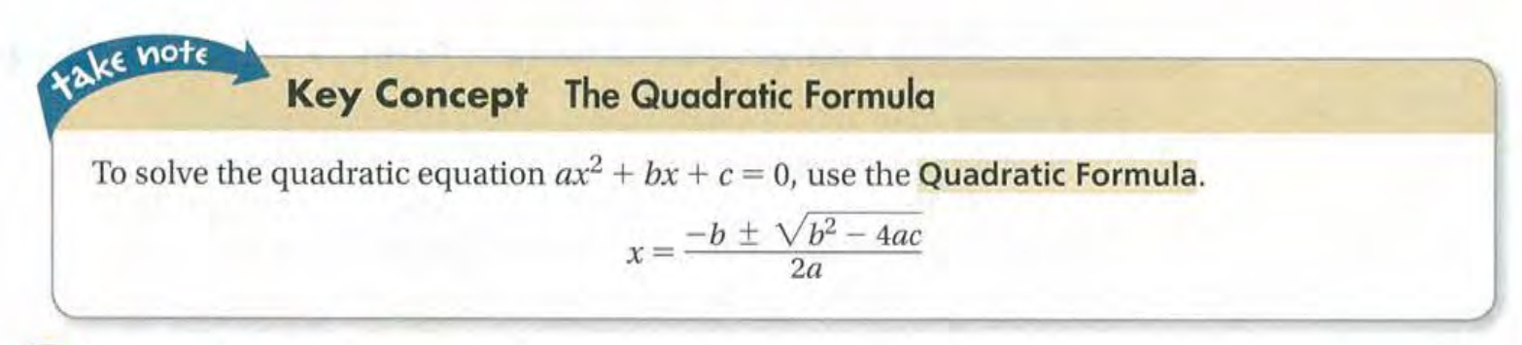

Slide 23
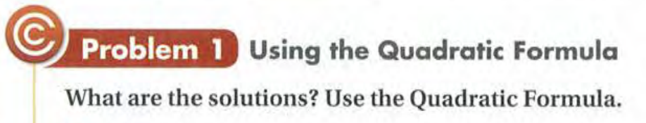
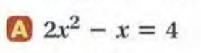
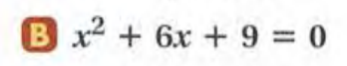

Slide 24
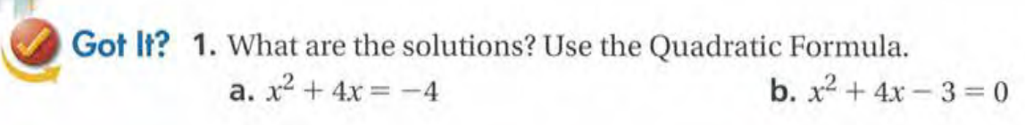

Slide 25
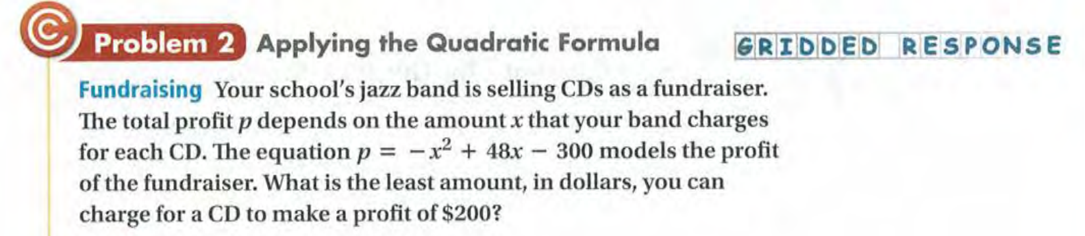

Slide 26
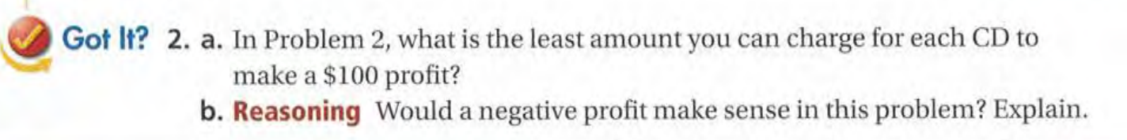

Slide 27
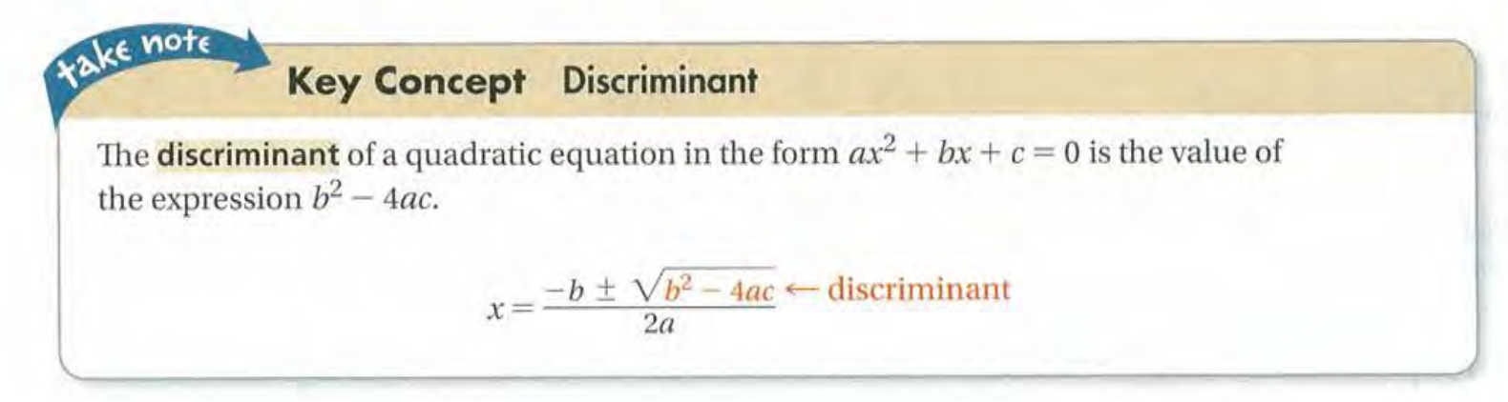

Slide 28
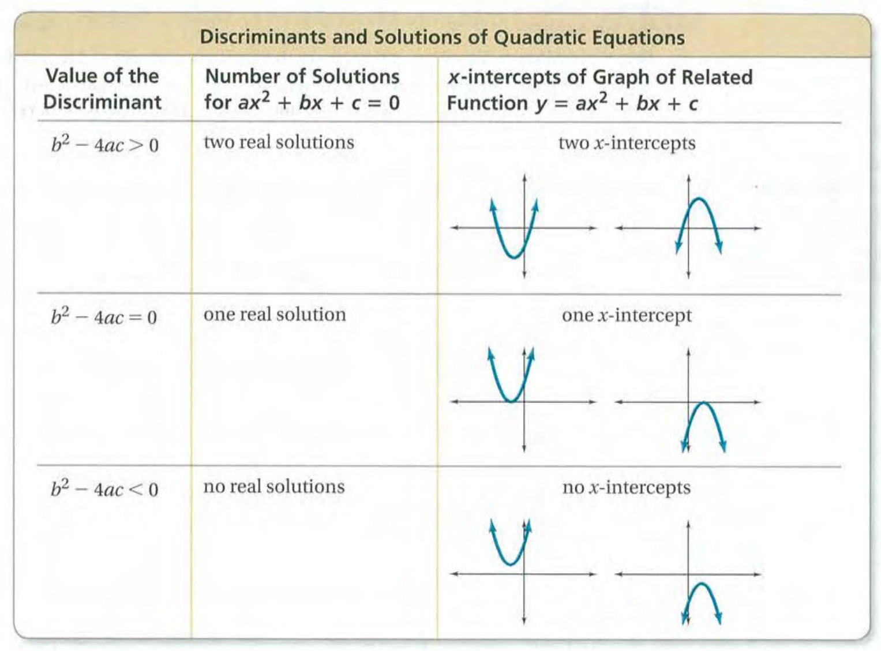

Slide 29
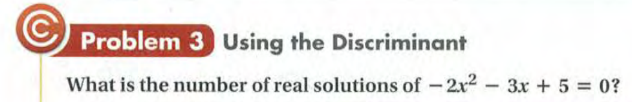

Slide 30
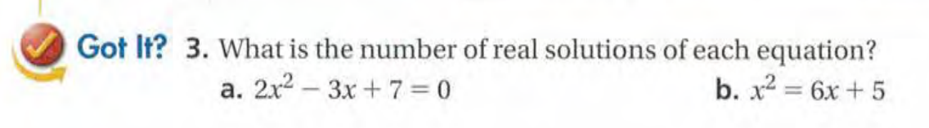

Slide 31
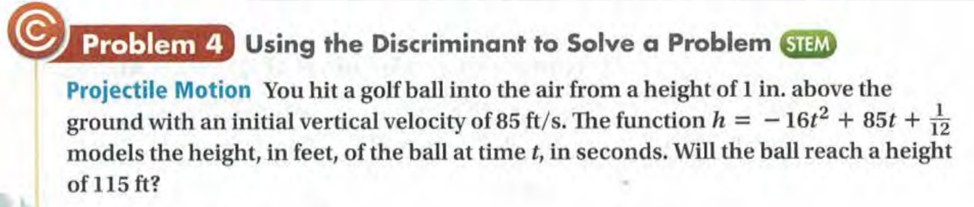

Slide 33
Exit Card:
Complete the quadratic formula learning sheet!
Work on your project if you finish early.

Slide 34
Advance organizer
Learning objectives:
Understand 4.8 Complex Numbers
Prior knowledge:
Understand 4.7 The Quadratic Formula
Successful criteria:
Controlled Practice: Complete the Exit Card
Freer Practice: Complete questions to your interest
Learning activities:
1. Preview and Vocabulary Check (10 minutes):
Quickly scan through the text and noting any unfamiliar terms.
2. Comprehend the Presentation (45 minutes):
3. Exit Card Completion (25 minutes):
4. Main Idea Summary and Reflection (5 minute):

Slide 35
Key terms:
Imaginary number[虚数]: An imaginary number is a number that can be written as a real number multiplied by the imaginary unit "i," where "i" is defined as the square root of -1. Imaginary numbers are often used in mathematics to extend the set of real numbers to include numbers that do not have real solutions, such as the square root of -1.
Complex number[复数]: A complex number is a imaginary part (bi), and they can be used to represent quantities involving both real and imaginary components.
Complex number plane [复平面]: The complex number plane, also known as the complex plane or Argand plane, is a two-dimensional coordinate system where complex numbers are represented graphically. The horizontal axis represents the real part of a complex number, while the vertical axis represents the imaginary part.
Complex conjugate [复共轭]: The complex conjugate of a complex number "a + bi" is obtained by changing the sign of the imaginary part, resulting in "a - bi." In other words, the complex conjugate of a complex number switches the sign of its imaginary component while keeping the real part unchanged.

Slide 36
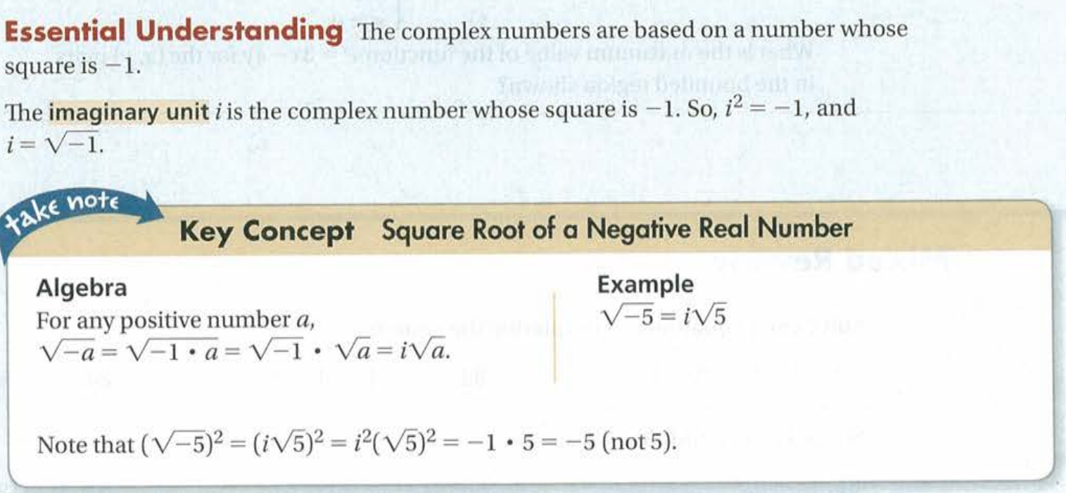

Slide 37
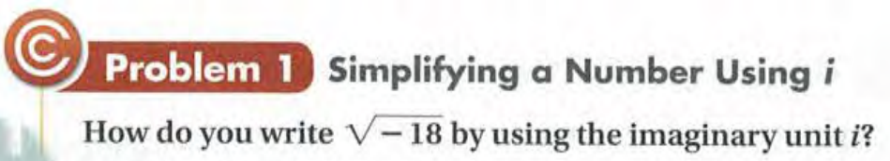

Slide 38
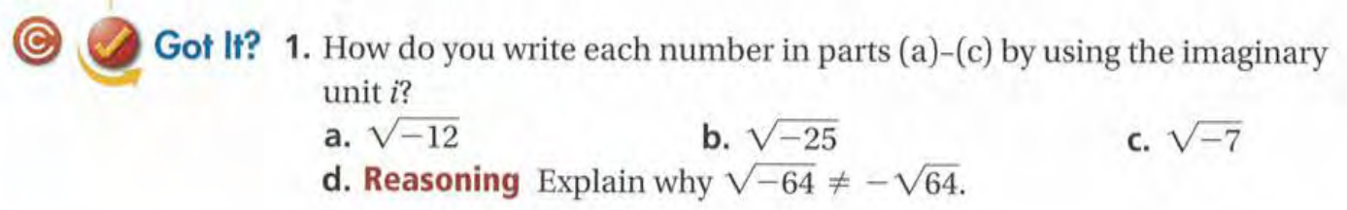

Slide 39
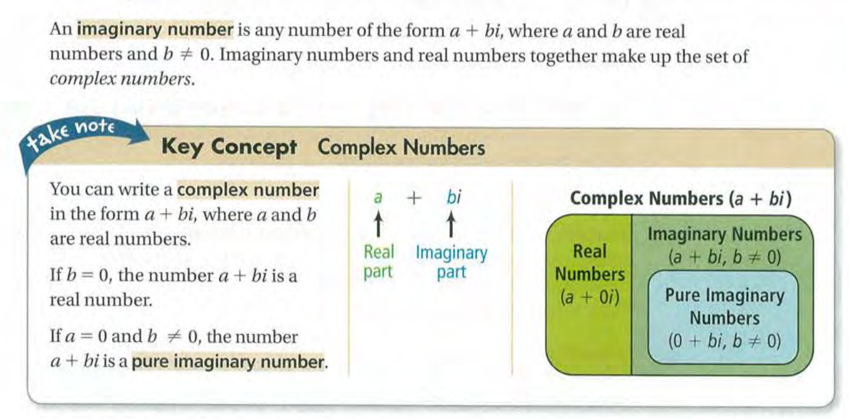

Slide 40
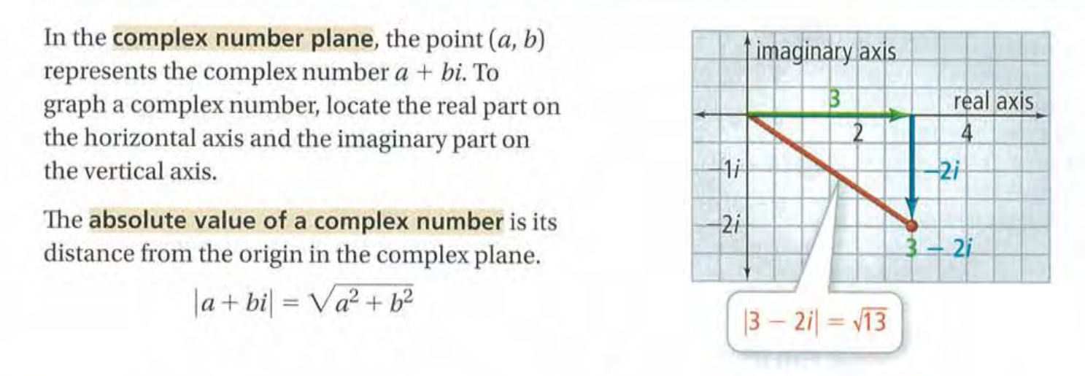

Slide 41
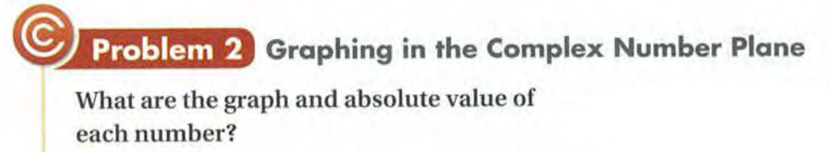
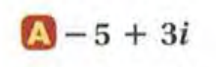
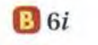

Slide 42
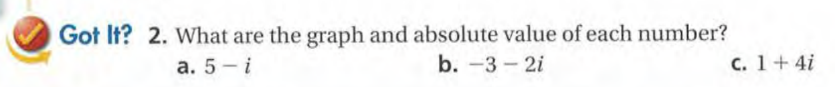

Slide 43
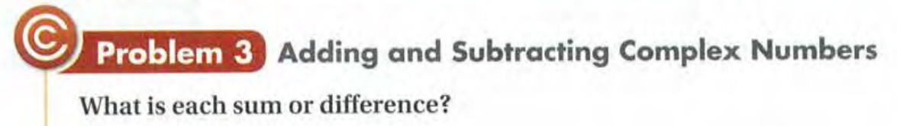
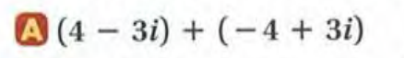
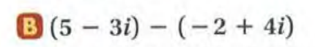

Slide 44
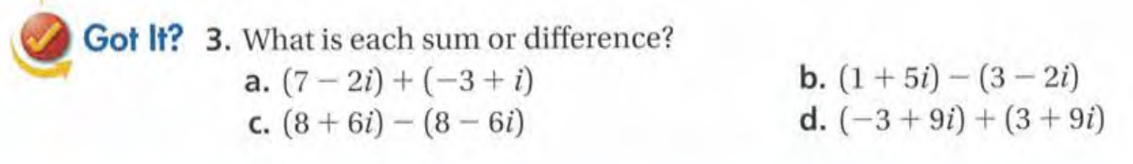

Slide 45
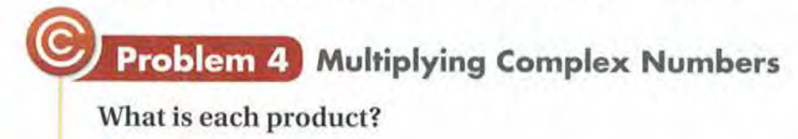
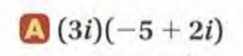
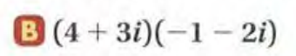
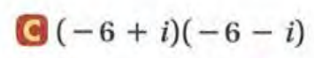

Slide 46
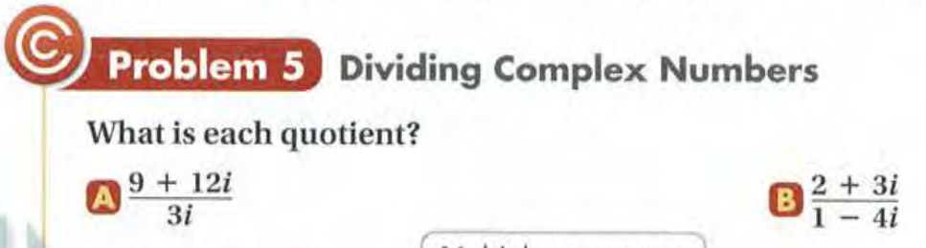

Slide 47
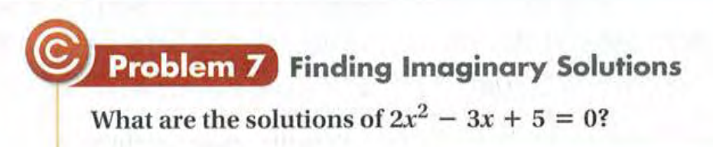

Slide 48
Exit Card:
Complete the complex number learning sheet!

